Slide 1

I Believe: An Alien Analysis
By: Group 10
Megan Cross, Nate Kelly, Heather Allardice, Melissa Wiese
Elizabeth Pasi Schiffman, and Jocelyn Conard

Slide 2
Motivation (Project Details)
Reported UFO sightings in the United States from 1993-2014
Good dataset to look for patterns, trends, or correlations
Dataset was large enough to accomplish our tasks
A topic that wasn’t controversial yet interesting
Notes:
Why did we choose the topic of reported UFO sightings

Slide 3
The Data Sources
UFO reported sightings csv file from Kaggle.com
Sourced from National UFO Reporting Center (NUFORC)
Google geolocation API
US Census 2010 API
Notes:
UFO Sightings: https://www.kaggle.com/NUFORC/ufo-sightings?select=scrubbed.csv

Slide 4
Questions
Where are most reported UFO sightings by population?
What UFO shape was most frequently sighted?
How long are reported UFO sightings in seconds?
Are there any correlations between reported UFO sightings and demographic information?

Slide 5
Data Cleanup & Exploration
Started with csv file for Kaggle.com
Cleaned and organized the data to bring scope to US from 1993-2014
Converted datetime to Month, Day, and Time
Convert Day to weekday
Dropped NA’s
Added County Data from Google API
Added region data
Added demographic information data from US Census API
Plotted sightings on a Map using GeoPandas

Slide 6
Data Analysis (Insights or Surprises)
Artifacts and more Artifacts
Spaces
Misspelling
Mistakes in data
County Level data not standardized
Discovered many ways to analyze the data

Slide 7
Data Analysis (Problems)
Different interpretations or perspectives of the data
Merging the data
Splitting the data
Which questions to keep and which to remove
Dropped unemployment data
Which charts to use to tell our story
Median vs Mean
Used Median due to large outliers
Most problems solved by communicating and Google

Slide 8
Data Analysis (Charts Created)
Map of all reported sightings from 1993 – 2014
Reported sightings per population in each state
Correlation between frequency of sightings and population
Frequency of UFO shapes reported by year
Median duration of reported sightings by shape
Correlation between frequency of sightings and US armed forces employment

Slide 9
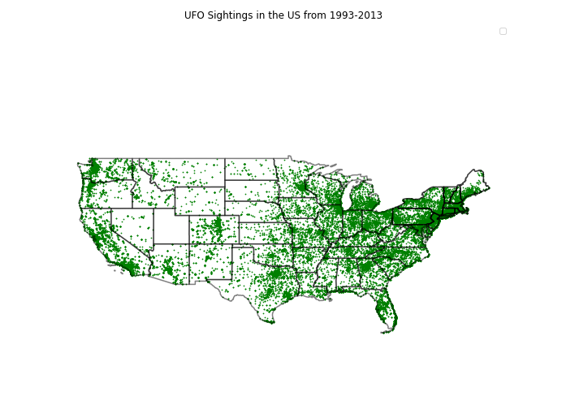

Slide 10
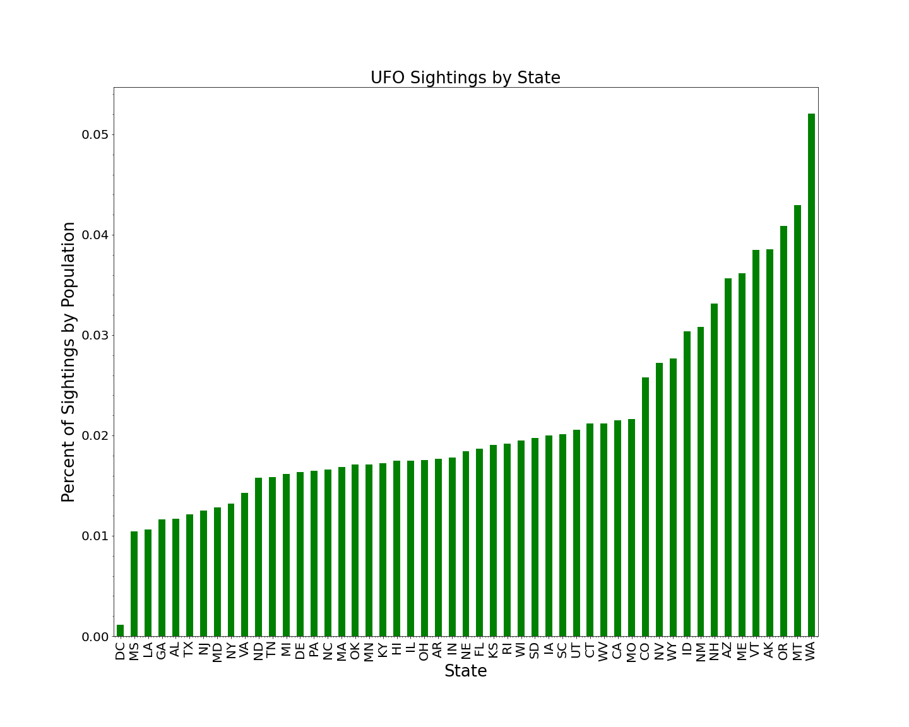

Slide 11
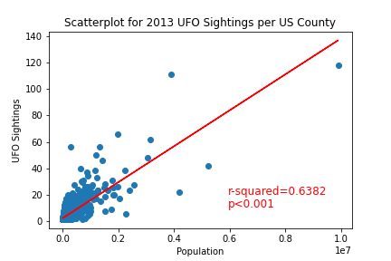

Slide 12
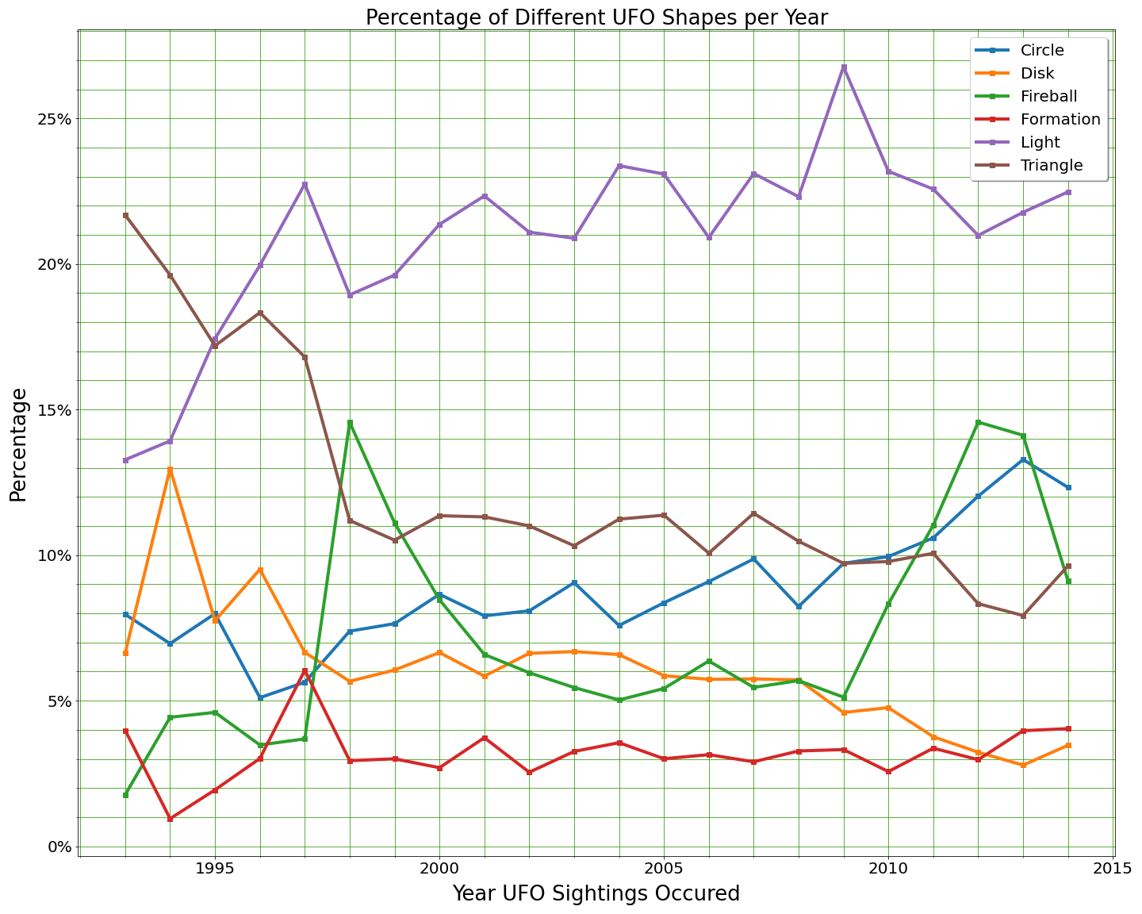

Slide 13
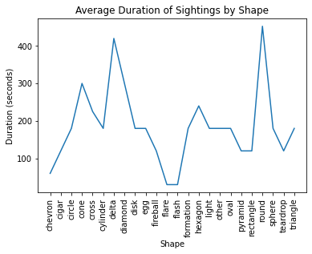

Slide 14
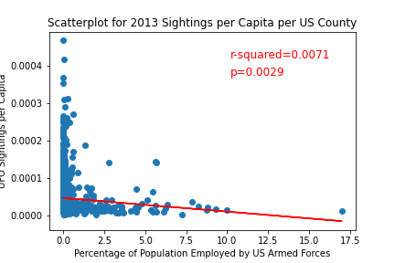

Slide 15
Conclusions
There are lights in the sky!
Natural phenomena or beings from another world?
Most sightings occur where there is the highest population density
The data is confounded by multiple factors that influence who reports UFO sightings
Sightings do not appear to be more frequent around military bases
Most sightings are short in duration, lasting 2-4 minutes
Some shapes tend to last longer

Slide 16
Postmortem
Additional areas to research
One state over time
Map data onto more types of GIS maps
Revolving globe map, including international data
Is proximity to airport related to UFO sightings
Is alcohol and drug use related to UFO sightings
Is political affiliation related to UFO sightings

